Slide 1
Supermarket Sales
Analysis, Insights, Takeaways Presented by - Nicholas Kelsey Setiadi

Slide 2
Objective
Identify insights on Sales Trends, Product Performance, and Customer Segments & provide actionable recommendations.

Slide 3
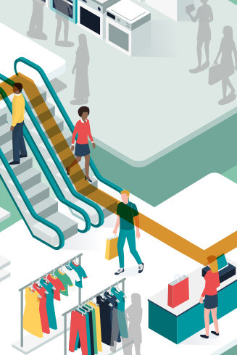
Data Overview
01
02
Supermarket’s product sales data collected from each transaction, also includes some customer information.
Data ranges between January 1 - March 30, 2019.
* Data is taken from Kaggle’s supermarket sales dataset

Slide 4
Sales Trends

Slide 5
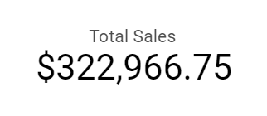
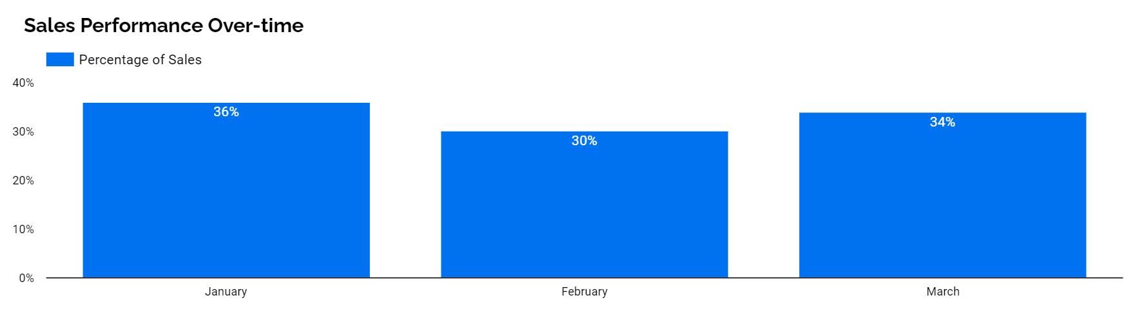
Which Month Records the Highest Sales? 01
Highest sales occurred in January, accounting for 36% of total sales.
Sales could be affected by seasonal factors (i.e. Post-holiday discounts) [1]
$ 116,292
$ 97,219
$ 109,456

Slide 6
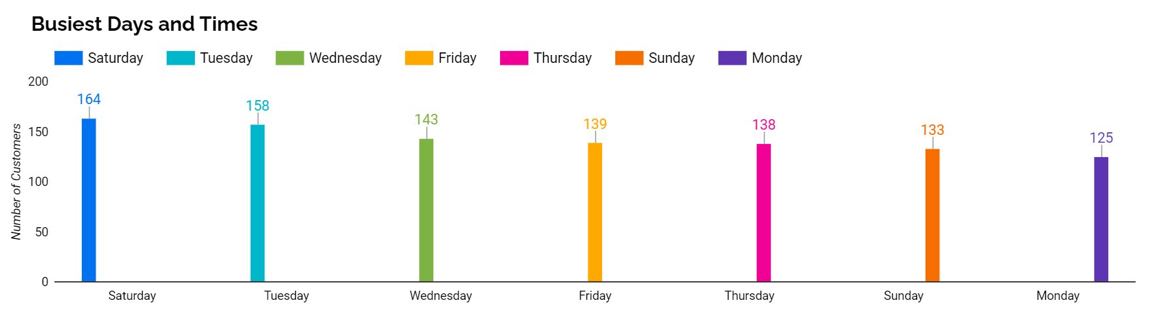
Which Days of the Month are the Busiest? 02
Number of customers during Saturdays were the highest, Mondays were the least.
Saturday marks the start of the weekend.
Tuesdays are also observed to have a high number of customers.

Slide 7
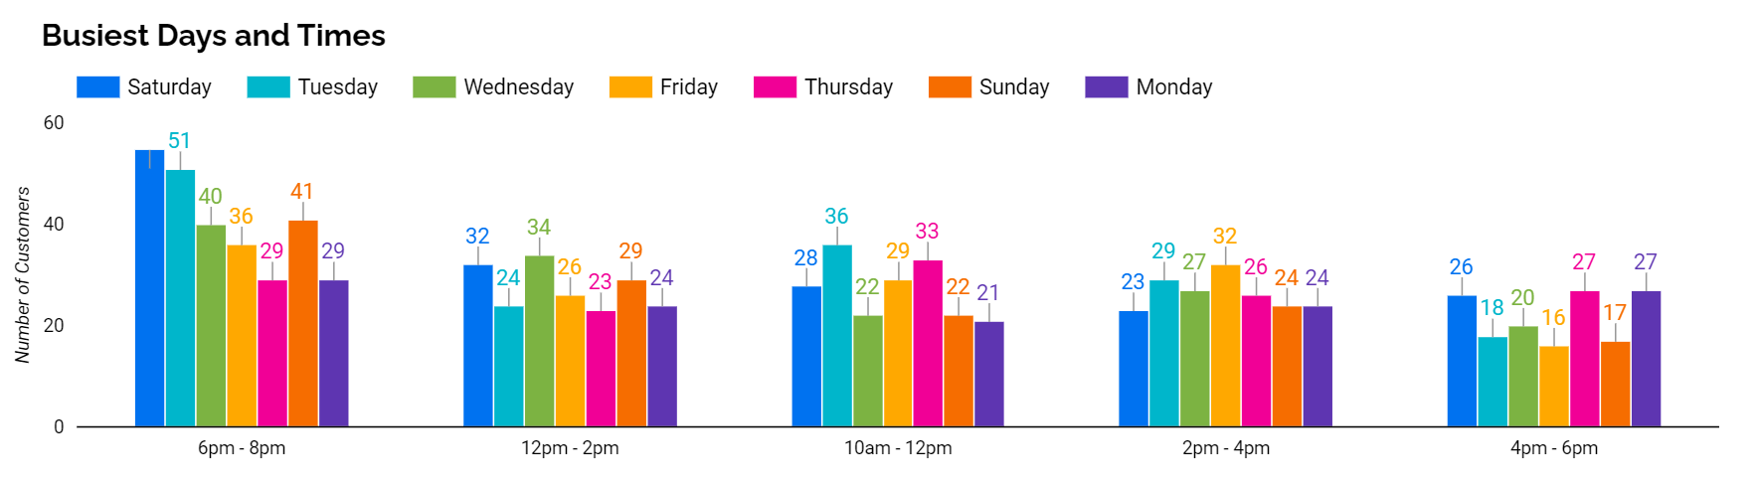
Which Times of Day are the Busiest? 03
It’s busiest during 6pm to 8pm, and the least busy time is during 4pm to 6pm.
Customers prefer to run errands after office/activity hours.
12pm to 2pm are also observed to have a high number of customers.

Slide 8
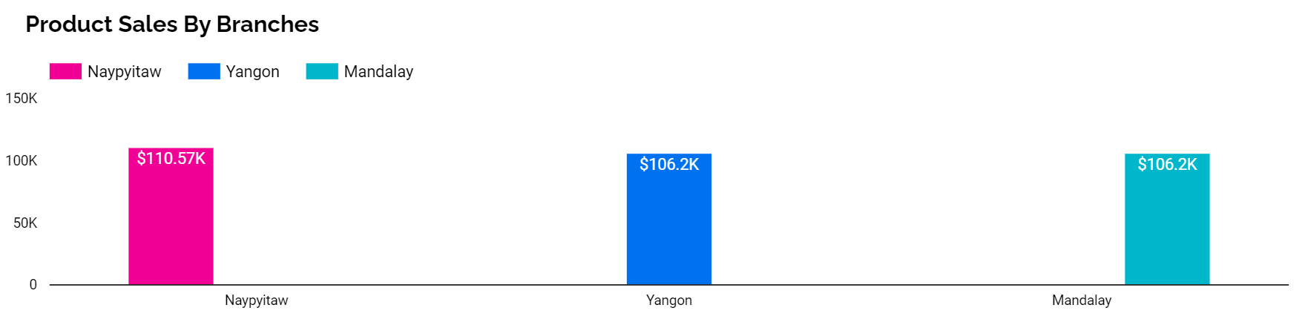
Which Branch Records the Highest Sales? 04
Naypyitaw captures the most sales.
Average product prices are higher due to being Myanmar’s capital city.
Naypyitaw | Mandalay | Yangon
$ 56.6 | $ 55.6 | $ 54.7

Slide 9
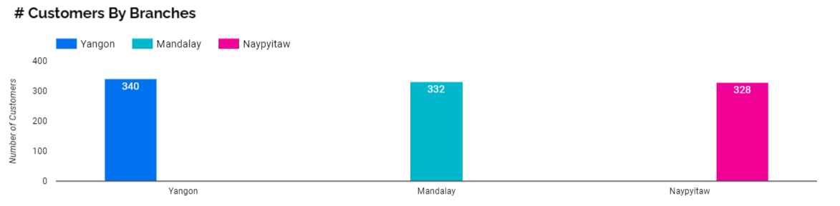
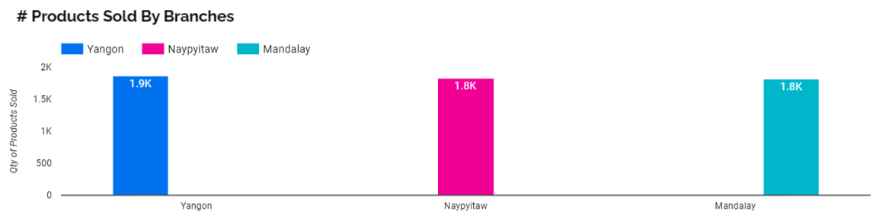
Which Branch is the Busiest? 05
Yangon has the most number of customers AND units sold.
Yangon is the commercial & cultural capital, with the largest population amongst all cities in Myanmar. [2]
Customers
Units Sold

Slide 10
Product Performance

Slide 11
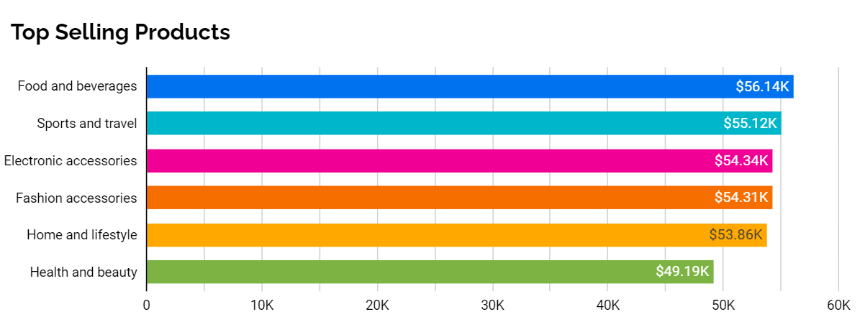
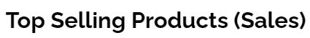
Which Product Line Sells the Best? 01a
Overall, Food and Beverages generate the most Sales this quarter.
Followed by Sports and Travel and Electronic Accessories after.
17.38 %
17.07 %
16.82 %
16.81 %
16.68 %
15.23 %

Slide 12
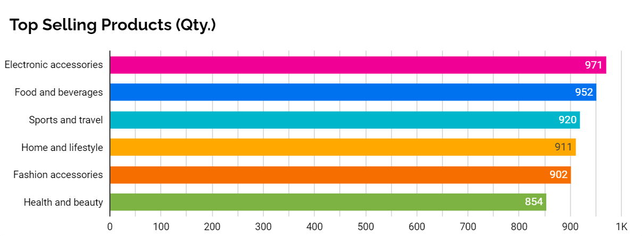
Which Product Line Sells the Best? 01b
However, Electronic Accessories remain the best seller in terms of Quantity.
Food and Beverages and Sports and Travel still remain within top 3 product lines.
17.38 %
17.07 %
16.82 %
16.81 %
16.68 %
15.23 %

Slide 13
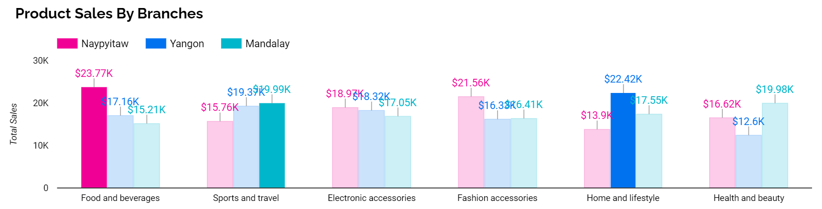
Which Product Line Sells the Best in each Branch? 02
Naypyitaw → Food and Beverages
Electronic Accessories and Fashion Accessories also has high sales (i.e. Capital city’s popularity, faster product growth).
Yangon → Home and Lifestyle
Mandalay → Sports and Travel

Slide 14
Customer Segments

Slide 15
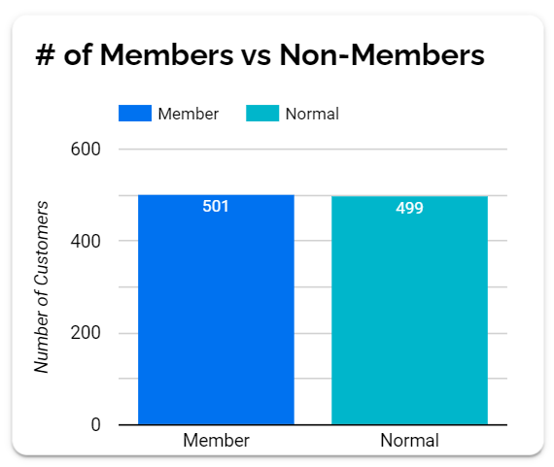
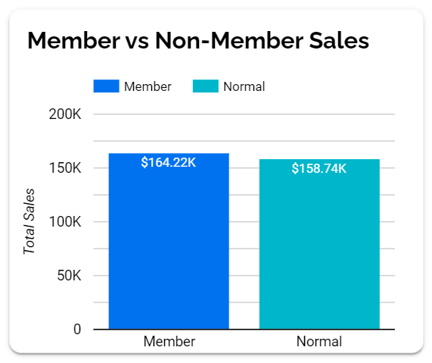
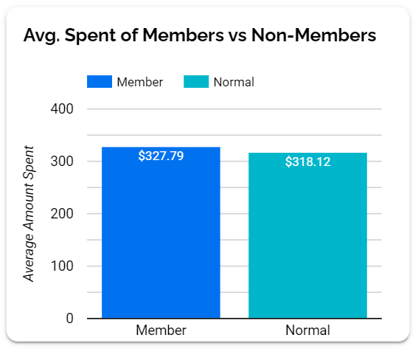
Members vs. Non-Members: Who Drives Sales? 01
Members generate slightly (1.7 % ↑) more sales.
The number of Members vs Non-Members are roughly equal.
Members spend 1.5 % more on average.
50.85 %
49.15 %
50.85 %
49.15 %
$ 116,292
$ 97,219
$ 109,456

Slide 16
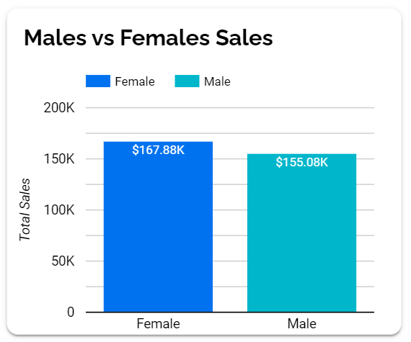
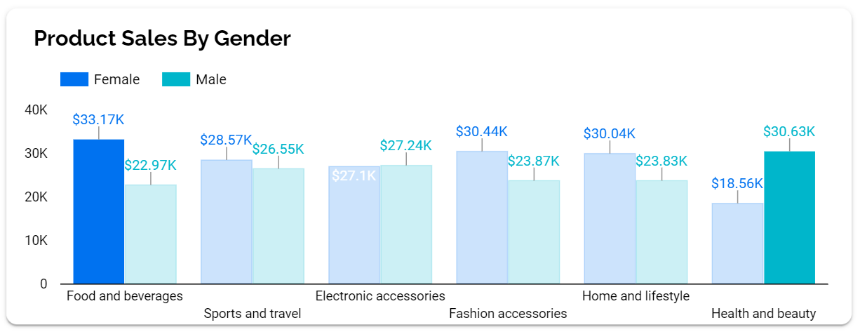
What do Males vs. Females Spend on? 02
Females generate slightly (3.9 % ↑) more sales than Males.
Females spend on Food and Beverages the most.
Surprisingly, Males spend on Health and Beauty the most.
51.98 %
48.02 %
50.85 %
49.15 %
$ 97,219
$ 109,456

Slide 17
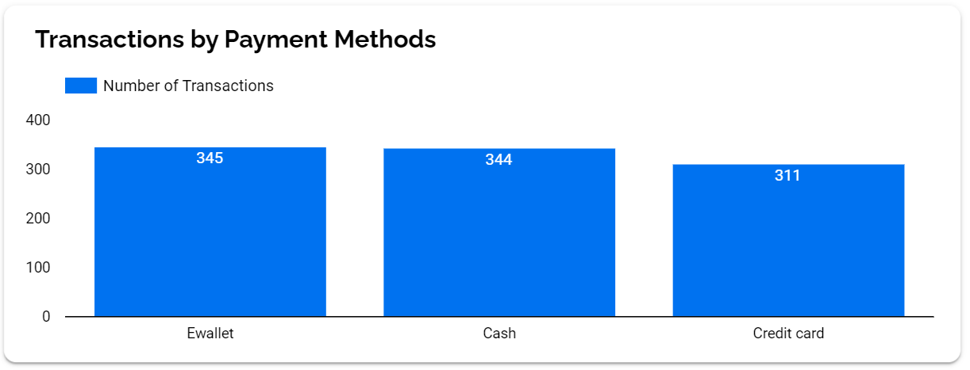
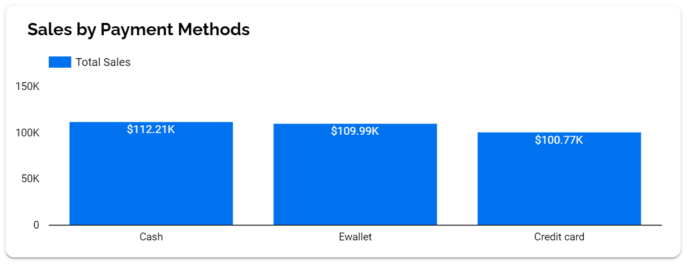
Which Payment Method do Customers Prefer? 03
Ewallet seems to be the most popular payment method.
However, transactions using Cash generate higher total sales.
51.98 %
48.02 %
$ 97,219
$ 109,456

Slide 18




Key Takeaways & Recommendations
Highest sales throughout the quarter is seen in January. Capitalize on seasonal factors such as end-of-season discounts to further improve sales.
1
The supermarket is busiest on Saturdays, 6pm - 8pm.
Optimize staff allocation.
Keep items well-stocked.
Special end-of-day promotions, maximizing items sold (i.e. Food).
2
Despite Naypyitaw having the highest sales, Yangon is a close 2nd and has more customers & items sold.
Create initiatives (i.e. marketing campaigns) to drive sales in Yangon further, as it has more potential customers.
3

Slide 19


Key Takeaways & Recommendations
4
Top 3 product lines are Food and Beverages, Electronic Accessories, Sports and Travel.
Optimize product placement and visibility.
Create cross-promotions and attractive displays.
Allocate products across branches based on popularity.
Members spend slightly more than non-members on average.
Create attractive benefits (i.e. exclusive offers) to encourage more customers to join.
Females often spend on Food and Beverages and Males often spend on Health and Beauty products.
Tailor marketing strategies to appeal to gender-specific preferences.
E-wallet is the most popular payment method.
Promote payment using e-wallets as a payment method (i.e. discounts or incentives.)
5

Slide 20
Thank you for your time and attention 🙂

Slide 21
References -
[1] Post-Holiday Spending: What Do Consumers Buy In January? https://www.capstonelogistics.com/blog/post-holiday-spending-what-do-consumers-buy-in-january/
[2] Population of Cities in Myanmar (2023) https://worldpopulationreview.com/countries/cities/myanmar

